Slide 1
The Boy In The Striped Pajamas
Setting Project.
By: Dakota Lynn

Slide 2
Home in Berlin
Un-original, 5 leveled house counting basement and small room above the whole house.
Near Bruno and Gretel's grandparents home.
Close to fruit and vegetable stands.
In the city.

Slide 3
Out-With Home
Very original, all houses around are one level original homes.
Small town, in the middle of know where(it seems).
3 levels to home.

Slide 4
What Lies Beyond The Walls
Outside Bruno’s Window
Outside Gretel’s Window
Young boys, short and tall, small and some larger than others. Older men, and all the in-between.
Dusty roads, full of dirty boys/ men lined up in striped pajamas and a matching hat.
Parking-lot, with a few cars.
A couple of soldiers standing around, looking suspicious.

Slide 5
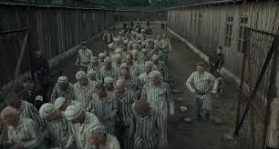
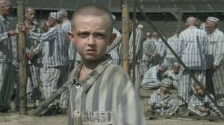
Pictures of the Victims.
Young child training for navy.
Men about to be punished.
Older men, and young boys standing around.
Boy in striped pajamas, along fence.

Slide 6
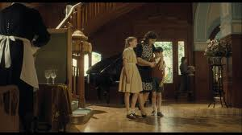
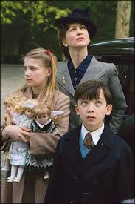
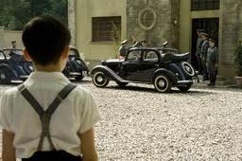
“Perfect People”
“Perfect” Family.
Bruno and his family.
Gretel watching, the soldiers discuss important things.

Slide 7
Author Of “The Boy In The Striped Pajamas” John Boyne.
Born In Dublin Ireland, in 1971. Studied at English Literature at Trinity College, Dublin, and creative writing at the University of East Anglia, Norwich, where he was awarded the Curtis Brown prize. He published “The Boy In The Striped Pajamas” in 2006.

